Slide 1
TRANSFORMS

Slide 2
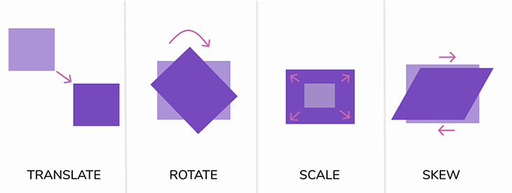
TRANSFORMS
The CSS property transform is useful in rotation, scaling, skewing, or translation of an element.

Slide 3
TRANSLATE
The translate() CSS function allows you to change the position of elements.
The translate() CSS function defines x- and y-coordinates of an element in 2D. You can also define the z-coordinate to change position in 3D.
2D Translate
Transform: translate(x-axis, y-axis);
translate: x-axis y-axis;
3D Translate
Transform: translate3d(x-axis, y-axis, z-axis);
translate3d() - CSS | MDN

Slide 4
ROTATE
The rotate() CSS function defines a transformation that rotates an element around a fixed point on the 2D plane, without deforming it. Its result is a <transform-function> data type.
2D Translate
Transform : rotate(deg);
3D Translate
Transform : rotate3d(x, y, z, deg);
Vector defined by the x, y, and z values
Grad : Gradians, where 400 gradians equal a full circle.
Rad : Radians, where 2π radians equal a full circle.
Turn : Turns, where 1 turn equals a full circle.
rotate3d() - CSS | MDN

Slide 5
SCALE
The scale() CSS function allows you to change the size of elements.
The scale() CSS function defines values for how much an element is scaled in x- and y-directions. You can also define how much an element is scaled in z-direction.
2D Scale
Transform : scale(x-axis, y-axis);
scale : x-axis y-axis;
3D Scale
Transform: Scale3d(x-axis, y-axis, z-axis);
scale3d() - CSS | MDN

Slide 6
SKEW
The skew() CSS function defines a transformation that skews an element on the 2D plane.
Transform : skew( ax );
Transform : skew( ax, ay );
ax - Horizontal axis to distort an element.
ay - Vertical axis to distort an element.

Slide 7
Thank you …
Any question ?

